Slide 1

Galgotias University
School of Computing Science & Engineering
Programme Name: B.Tech in CSE Course Code : BCSE2354
Course Name: Artificial Intelligence
Name of the Faculty: Mr. Janarthanan.S

Slide 2
School of Computing Science & Engineering
Course Code : BCSE2354 Course Name: Artificial Intelligence
Prerequisites / Recap
Artificial Intelligence - Neural Networks
What are Artificial Neural Networks (ANNs)?
The inventor of the first neurocomputer, Dr. Robert Hecht-Nielsen, defines a neural network as −
"...a computing system made up of a number of simple, highly interconnected processing elements, which process information by their dynamic state response to external inputs.”
Name of the Faculty: Mr. Janarthanan.S Programme: B.Tech (Spl)

Slide 3
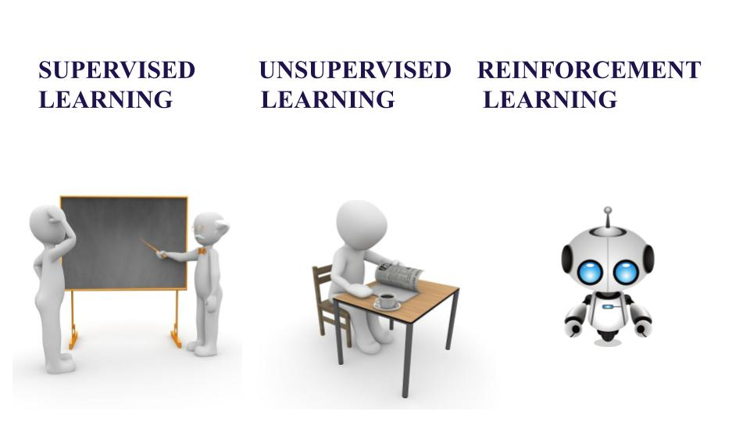
School of Computing Science & Engineering
Course Code : BCSE2354 Course Name: Artificial Intelligence
Topic: Types of Learning in AI
Name of the Faculty: Mr. Janarthanan.S Programme: B.Tech (Spl)

Slide 4

School of Computing Science & Engineering
Course Code : BCSE2354 Course Name: Artificial Intelligence
Types of Learning in AI Visual Representation
Name of the Faculty: Mr. Janarthanan.S Programme: B.Tech (Spl)

Slide 5
School of Computing Science & Engineering
Course Code : BCSE2354 Course Name: Artificial Intelligence
Explanation: Types of Learning in AI
Machine Learning is a part of Computer Science where the efficiency of a system improves itself by repeatedly performing the tasks by using data instead of explicitly programmed by programmers. Further let us understand the difference between three techniques of Machine Learning-
1.Supervised,
2.Unsupervised and
3.Reinforcement Learning.
Name of the Faculty: Mr. Janarthanan.S Programme: B.Tech (Spl)

Slide 6
School of Computing Science & Engineering
Course Code : BCSE2354 Course Name: Artificial Intelligence
Explanation: Types of Learning in AI
Supervised Learning
Consider yourself as a student sitting in a classroom wherein your teacher is supervising you, “how you can solve the problem” or “whether you are doing correctly or not”. Likewise, in Supervised Learning input is provided as a labelled dataset, a model can learn from it to provide the result of the problem easily.
Types of Problems
Supervised Learning deals with two types of problem- classification problems and regression problems.
Name of the Faculty: Mr. Janarthanan.S Programme: B.Tech (Spl)

Slide 7
School of Computing Science & Engineering
Course Code : BCSE2354 Course Name: Artificial Intelligence
Explanation: Types of Learning in AI
Classification problems
This algorithm helps to predict a discrete value. It can be thought, the input data as a member of a particular class or group. For instance, taking up the photos of the fruit dataset, each photo has been labelled as a mango, an apple, etc. Here, the algorithm has to classify the new images into any of these categories. Examples:
Naive Bayes Classifier, Support Vector Machines , Logistic Regression
Regression problems
These problems are used for continuous data. For example, predicting the price of a piece of land in a city, given the area, location, number of rooms, etc. And then the input is sent to the machine for calculating the price of the land according to previous examples. Examples-
Linear Regression , Nonlinear Regression, Bayesian Linear Regression
Name of the Faculty: Mr. Janarthanan.S Programme: B.Tech (Spl)

Slide 8
School of Computing Science & Engineering
Course Code : BCSE2354 Course Name: Artificial Intelligence
Explanation: Types of Learning in AI
Unsupervised Learning
This learning algorithm is completely opposite to Supervised Learning. In short, there is no complete and clean labelled dataset in unsupervised learning. Unsupervised learning is self-organized learning. Its main aim is to explore the underlying patterns and predicts the output. Here we basically provide the machine with data and ask to look for hidden features and cluster the data in a way that makes sense. Example
K – Means clustering
Neural Networks , Principal Component Analysis
Name of the Faculty: Mr. Janarthanan.S Programme: B.Tech (Spl)

Slide 9
School of Computing Science & Engineering
Course Code : BCSE2354 Course Name: Artificial Intelligence
Explanation: Types of Learning in AI
Reinforcement Learning
It is neither based on supervised learning nor unsupervised learning. Moreover, here the algorithms learn to react to an environment on their own. It is rapidly growing and moreover producing a variety of learning algorithms. These algorithms are useful in the field of Robotics, Gaming etc.
Name of the Faculty: Mr. Janarthanan.S Programme: B.Tech (Spl)

Slide 10
School of Computing Science & Engineering
Course Code : BCSE2354 Course Name: Artificial Intelligence
Explanation: Types of Learning in AI
Reinforcement Learning
For a learning agent, there is always a start state and an end state. However, to reach the end state, there might be a different path. In Reinforcement Learning Problem an agent tries to manipulate the environment. The agent travels from one state to another. The agent gets the reward(appreciation) on success but will not receive any reward or appreciation on failure. In this way, the agent learns from the environment.
Name of the Faculty: Mr. Janarthanan.S Programme: B.Tech (Spl)

Slide 11
School of Computing Science & Engineering
Course Code : BCSE2354 Course Name: Artificial Intelligence
Summary of lecture followed by Questions for practice
Discussed about various Types of learning in AI with various fields
Questions:
How recent innovations more useful in recent days
What do you think about AI in future of learning
Any other learning types need to discuss with
Practice
Prepare multiple choice questions with answer conduct with either role play or quiz
Name of the Faculty: Mr. Janarthanan.S Programme: B.Tech (Spl)

